Slide 1
Lecture 10
Matrix condition number Applications

Slide 2
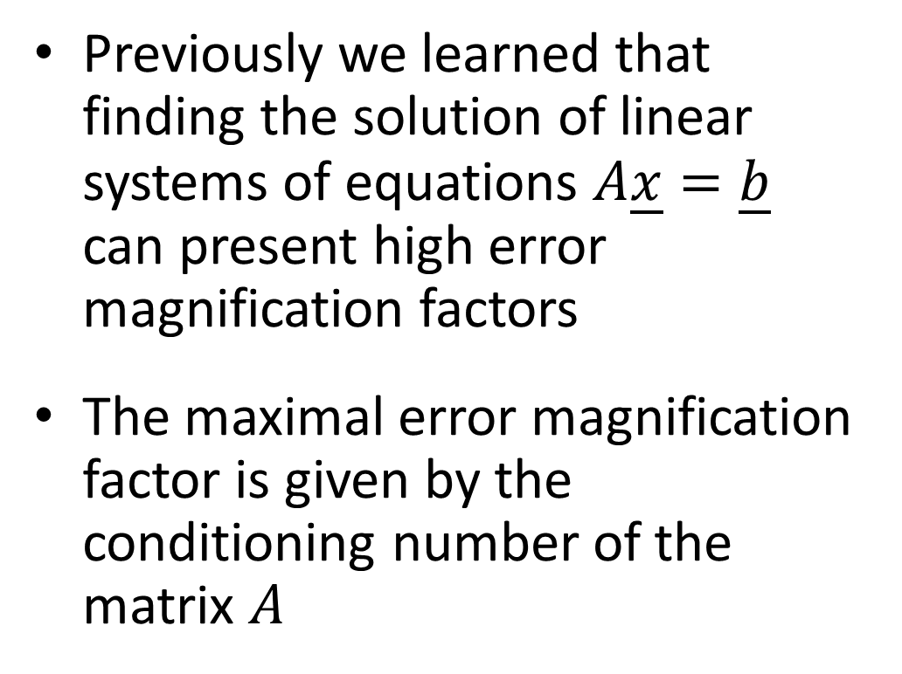


Introduction
Previously we learned that finding the solution of linear systems of equations $A\underline{x}=\underline{b}$ can present high error magnification factors
The maximal error magnification factor is given by the conditioning number of the matrix $A$
$$x_{2}$$
Nearly identical equations
Not well defined intercept
$$x_{1}$$
Notes:
Previously we learned that finding the solution of linear systems of equations $A\underline{x}=\underline{b}$ can present high error magnification factors
Geometrically a high error magnification factor comes from nearly identical equations which in turns makes it very tricky to identify clearly their intercept.
We learned as well that the maximal error magnification factor is given by the conditioning number of the matrix $A$
In this lecture we are going to learn how we can use the fact we are able to compute the error magnification factor.

Slide 3
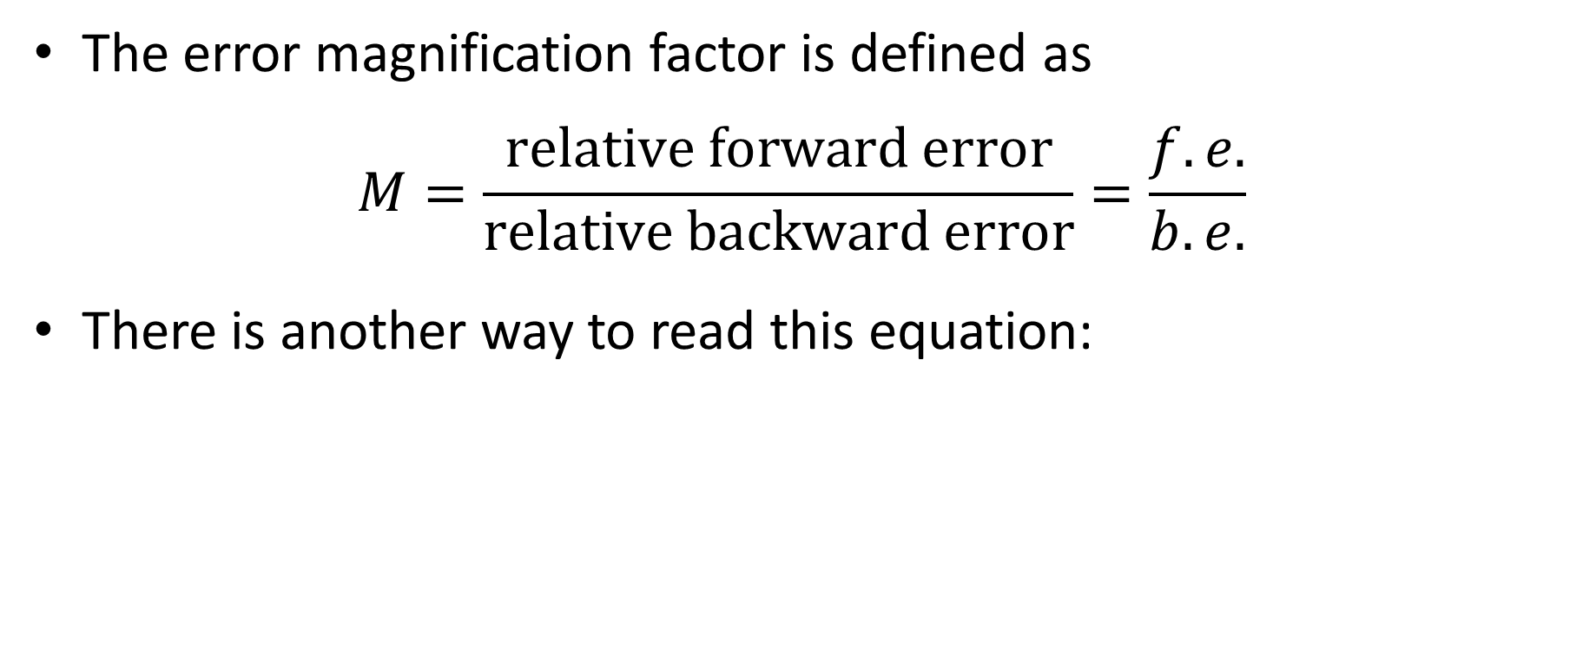

Introduction
The error magnification factor is defined as
$$M=\frac{\text{relative} \text{forward} \text{error}}{\text{relative} \text{backward} \text{error}}=\frac{f.e.}{b.e.}$$
There is another way to read this equation:
Input error
$$×M$$
Output error
Notes:
Recall that the error magnification factor is defined as the ratio between the relative forward and backward errors.
But there is another way to read the error magnification factor.
The error magnification factor M can be understood as the factor which amplifies an initial input error, for example round-off errors in the coefficient matrix A and right hand side vector b.
In short: output error is the input error times the error magnification factor

Slide 4
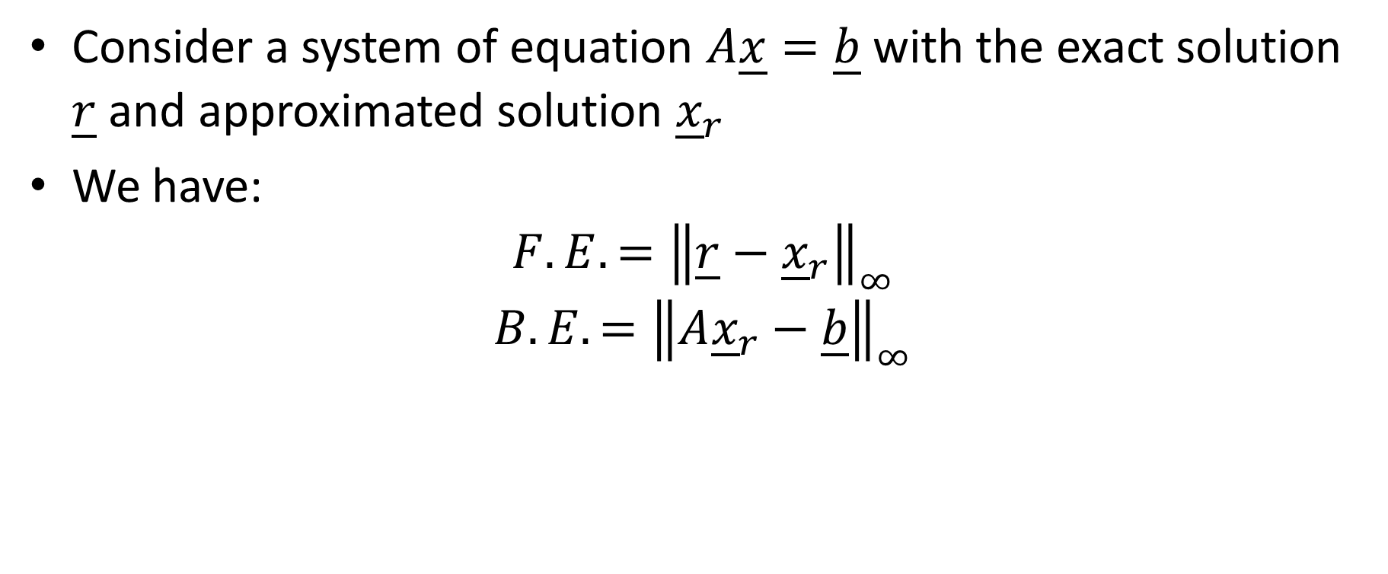
Consider a system of equation $A\underline{x}=\underline{b}$ with the exact solution $\underline{r}$ and approximated solution ${\underline{x}}_{r}$
We have:
$${F.E.=\left\|\underline{r}−{\underline{x}}_{r}\right\|}_{∞}$$
$${B.E.=\left\|A{\underline{x}}_{r}−\underline{b}\right\|}_{∞}$$
Notes:
To understand this second way to interpret the error magnification factor let us start by considering a system Ax=b with exact solution r and an approximated solution xr.
We know already that the absolute forward error is the infinity norm of the difference between the exact and approximated soliton
The absolute backward error, is the infinity norm of the error you get when you plug back your approximation into the system, that is the difference between Axr and b.

Slide 5
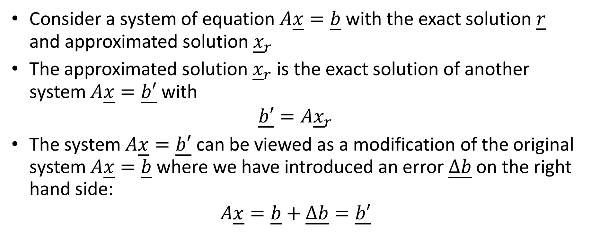
Alternative way to see it
Consider a system of equation $A\underline{x}=\underline{b}$ with the exact solution $\underline{r}$ and approximated solution ${\underline{x}}_{r}$
The approximated solution ${\underline{x}}_{r}$ is the exact solution of another system $A\underline{x}=\underline{b′}$ with
$$\underline{b′}=A{\underline{x}}_{r}$$
The system $A\underline{x}=\underline{b′}$ can be viewed as a modification of the original system $A\underline{x}=\underline{b}$ where we have introduced an error $\underline{∆b}$ on the right hand side:
$$A\underline{x}=\underline{b}+\underline{∆b}=\underline{b′}$$
Notes:
There is an alternate way to discuss the same situation
Consider again our system Ax=b with exact solution r and an approximation xr of this solution.
Now, we can say that the approximated solution xr is the exact solution of another system Ax=b’
In order this is indeed the case, the vector b’ must be choosen equal to Axr.
This new system Ax=b’ can be viewed as the original system Ax=b where the right hand side vector was modified by a vector delta b.

Slide 6


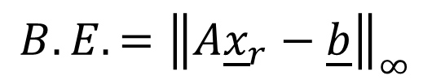
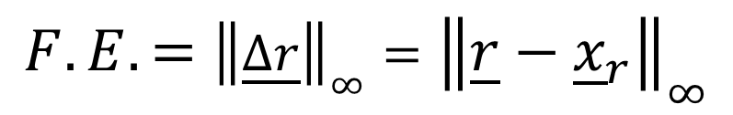
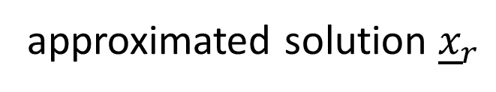
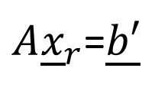
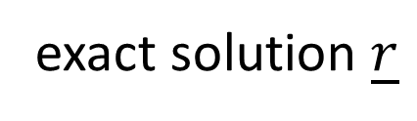
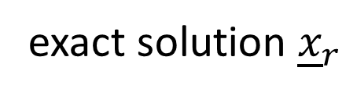
Original system
Modified system
exact solution $\underline{r}$
$$A\underline{x}=\underline{b}+\underline{∆b}=\underline{b′}$$
$$A\underline{x}=\underline{b}$$
approximated solution ${\underline{x}}_{r}$
exact solution ${\underline{x}}_{r}$
$${F.E.={\left\|\underline{∆r}\right\|}_{∞}=\left\|\underline{r}−{\underline{x}}_{r}\right\|}_{∞}$$
$A{\underline{x}}_{r}$=$\underline{b′}$
$${B.E.=\left\|A{\underline{x}}_{r}−\underline{b}\right\|}_{∞}$$
$${B.E.=\left\|A{\underline{x}}_{r}−\underline{b}\right\|}_{∞}{=\left\|\underline{b′} −\underline{b}\right\|}_{∞}={\left\|\underline{∆b}\right\|}_{∞}$$
Notes:
Let us write side by side these two point of views
On one side we have the original system Ax=b with exact solution r and an approximation xr
Forward and backward errors are defined according our well known relations
On the other side we have our modified system Ax=b’, where b’ is the vector b plus a vector Delta b.
This modified system has an exact solution xr, which means that the equation
Axr=b’ is satisfied exactly.
Let us now compare the two situations
If we calculate the backward error what do we get?
The backward error is the infinity norm of Axr-b.
But as Axr is as well equal to b’, we can say that the backward error is as well equal to the infinity norm of b’-b, which is the infinity norm of delta b.
[Note: if the animation can show term by term would be great]
This equation is key for the understanding of the rest of the lecture
It tells us that the backward error can be understood in two ways
On one side, the traditional way we did until now as the error you get when you plug back your approximation into the original equation
On the other side it can as well be understood as the error one has introduced in the right hand side vector b of the system Ax=b one wants to solve.

Slide 7

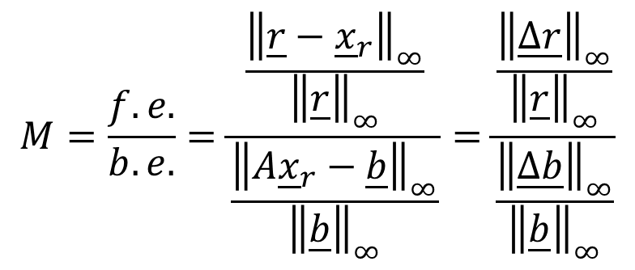
Alternate way to read error magnification factor
$$M=\frac{f.e.}{b.e.}=\frac{\frac{{\left\|\underline{r}−{\underline{x}}_{r}\right\|}_{∞}}{{\left\|\underline{r}\right\|}_{∞}}}{\frac{{\left\|A{\underline{x}}_{r}−\underline{b}\right\|}_{∞}}{{\left\|\underline{b}\right\|}_{∞}}}=\frac{\frac{{\left\|\underline{∆r}\right\|}_{∞}}{{\left\|\underline{r}\right\|}_{∞}}}{\frac{{\left\|\underline{∆b}\right\|}_{∞}}{{\left\|\underline{b}\right\|}_{∞}}}$$
$$\frac{{\left\|\underline{∆r}\right\|}_{∞}}{{\left\|\underline{r}\right\|}_{∞}}=M×\frac{{\left\|\underline{∆b}\right\|}_{∞}}{{\left\|\underline{b}\right\|}_{∞}}$$
Output error
Input error
Notes:
These two ways to read the backward error allows us as well to give an alternate way to read the error magnification factor
The error magnification factor is the ratio between relative forward and relative backward error.
But as the backward error can as well be interpreted as the error one has introduced in the vector b,
one can see the error magnification factor as the ratio between the relative forward error and the relative error in the right and side vector b.
Rearranging this equation allows us to write that the relative forward error is the error magnification factor times the relative error in the vector b.
Or in words: the output error is the error magnification times the input error

Slide 8
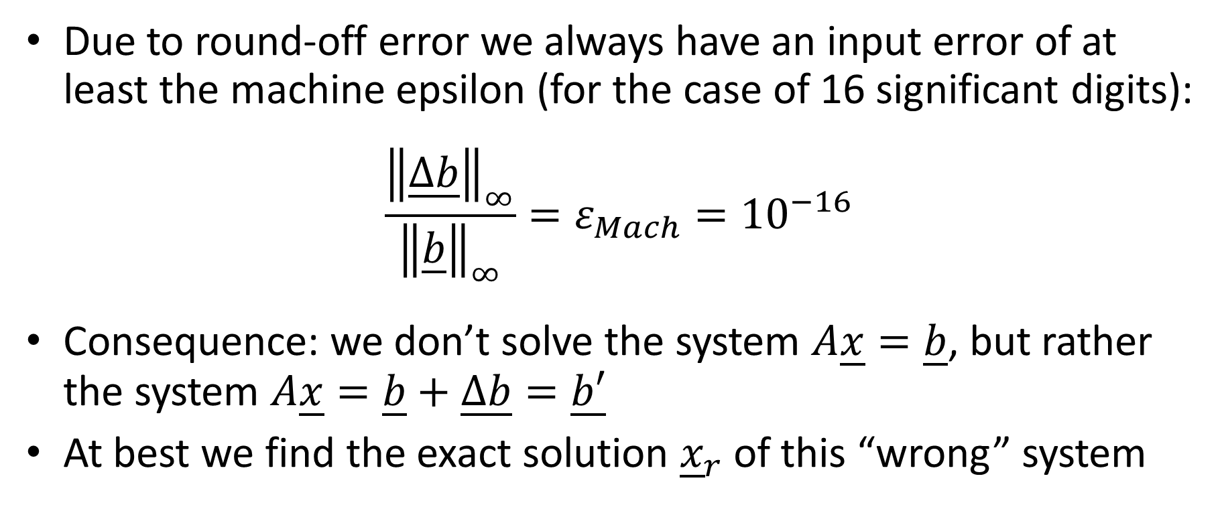
How can we use this result?
Due to round-off error we always have an input error of at least the machine epsilon (for the case of 16 significant digits):
$$\frac{{\left\|\underline{∆b}\right\|}_{∞}}{{\left\|\underline{b}\right\|}_{∞}}=ε_{Mach}={10}^{−16}$$
Consequence: we don’t solve the system $A\underline{x}=\underline{b}$, but rather the system $A\underline{x}=\underline{b}+\underline{∆b}=\underline{b′}$
At best we find the exact solution ${\underline{x}}_{r}$ of this “wrong” system
Notes:
How can we use this result?
First we should wonder how much is our input error.
In fact, due to round-off errors, we always have an input error of at least equal to the machine epsilon.
In the case of calculations using double precision floating numbers, this is 10 to the power -16
No number can be represented, when we start our calculations, better than with a relative error of 10 to the power -16
This has an important consequence.
First of all it means that we actually do not solve the problem Ax=b, but a different problem Ax=b’, where b’ is b plus the round-off error.
At best our algorithm will find the exact solution xr of this “wrong” system.
We will consequently find at best an error of r-xr when we try to solve Ax=b.

Slide 9
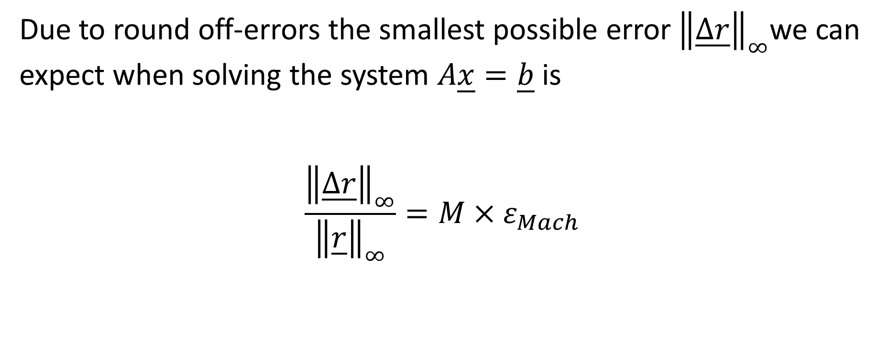
How can we use this result?
Due to round off-errors the smallest possible error ${\left\|\underline{∆r}\right\|}_{∞}$we can expect when solving the system $A\underline{x}=\underline{b}$ is
$$\frac{{\left\|\underline{∆r}\right\|}_{∞}}{{\left\|\underline{r}\right\|}_{∞}}=M×ε_{Mach}$$
Notes:
This means that due to round off-errors the smallest possible error we can expect when solving the system $A\underline{x}=\underline{b}$ is given by the machine epsilon times the error magnification factor
This result holds even if we use exact algorithms free of truncation errors such as the Gauss elimination algorithm family.

Slide 10
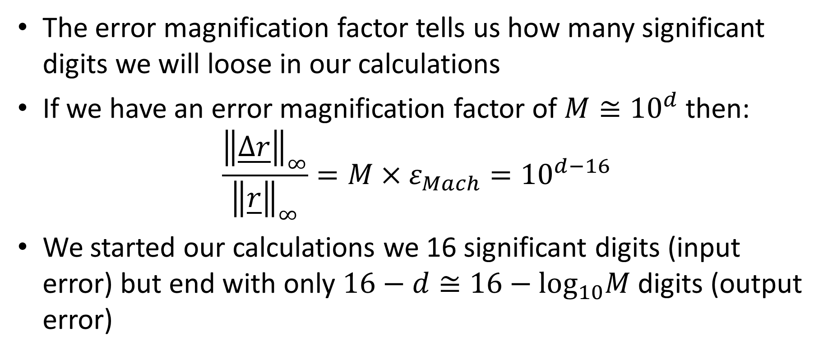
How can we use this result?
The error magnification factor tells us how many significant digits we will loose in our calculations
If we have an error magnification factor of $M≅{10}^{d}$ then:
$$\frac{{\left\|\underline{∆r}\right\|}_{∞}}{{\left\|\underline{r}\right\|}_{∞}}=M×ε_{Mach}={10}^{d−16}$$
We started our calculations we 16 significant digits (input error) but end with only $16−d≅16−\log_{10}M$ digits (output error)
Notes:
Consequently the error magnification factor tells us how many significant digits we will loose in our calculations
Consider for example an error magnification factor of about 10 to the power d.
Then the smallest forward error we can hope to expect when solving our system of equations is 10 to the power d minus 16
We stared our calculation with 16 correct significant digits.
But due to the error magnification factor, we can never get an solution better than 16-d digits.

Slide 11
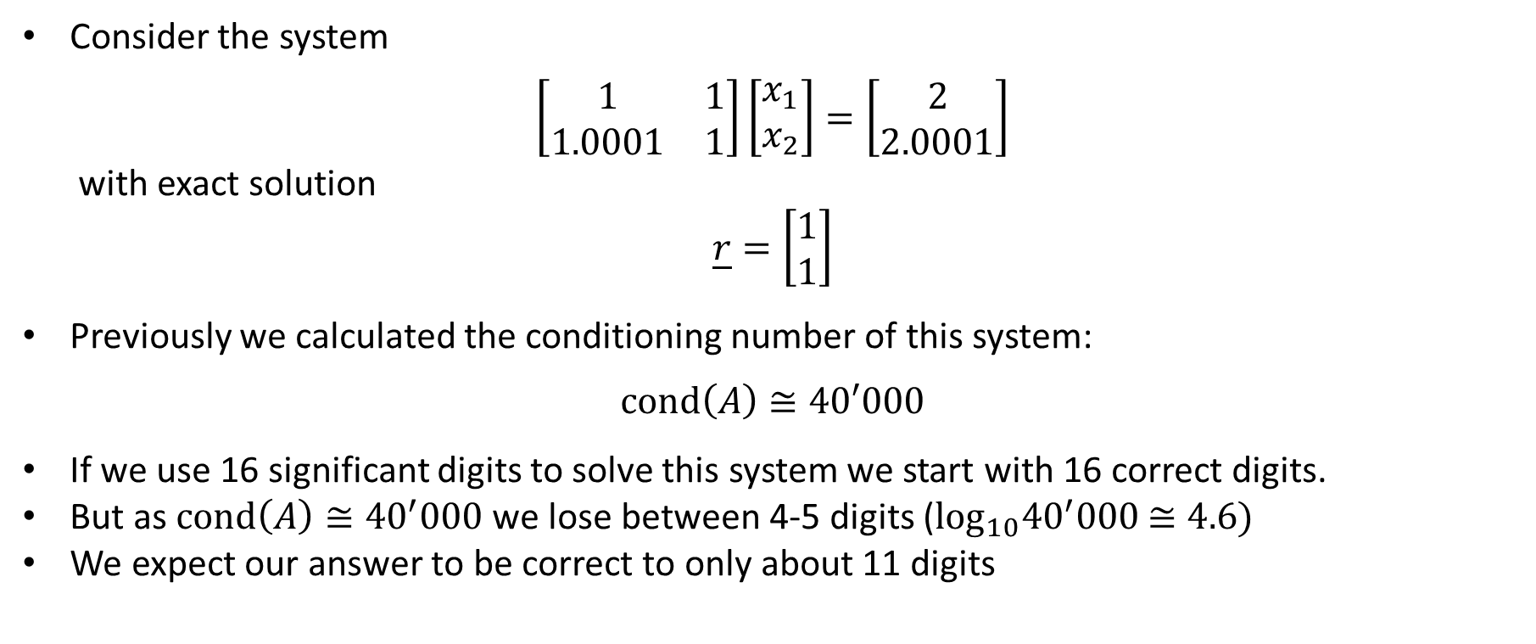
Example
Consider the system
$$\left[\begin{matrix}1 & 1 \\ 1.0001 & 1\end{matrix}\right]\left[\begin{matrix}x_{1} \\ x_{2}\end{matrix}\right]=\left[\begin{matrix}2 \\ 2.0001\end{matrix}\right]$$
with exact solution
$$\underline{r}=\left[\begin{matrix}1 \\ 1\end{matrix}\right]$$
Previously we calculated the conditioning number of this system:
$$\text{cond}\left(A\right)≅40′000$$
If we use 16 significant digits to solve this system we start with 16 correct digits.
But as $\text{cond}\left(A\right)≅{40}^{′}000$ we lose between 4-5 digits ($\log_{10}{40}^{′}000$ $≅4.6)$
We expect our answer to be correct to only about 11 digits
Notes:
We can apply this finding to our example from the previous lecture.
We considered the system displayed
In the previous lecture we calculated the conditioning number of A to be about 40’000
What does that tell us?
If we use double precision floating numbers, we represent our system with 16 correct digits
But as cond(A) is about 40’000, which is about 10^4.6, we will lose between 4 to 5 digits when we solve the system.
We can therefore expect an answer precise at best to 16-5=11 digits.

Slide 12
Example
Let us verify this statement in octave
Apparently octave finds the correct answer
octave> A = [1 1; 1.0001 1]; b=[2; 2.0001];
octave> x=A\b
ans =
1.00000
1.00000
Notes:
Is this really the case?
Let us verify this by using octave to solve our system
We start by defining our coefficient matrix A and right hand side vector b
Using the backward division command of octave will calculate the solution of the system using the PA=LU decomposition algorithm
Octave seems to find the right answer r which is 1 1.
Is this really the case?
We predicted that only 11 digits will be correct.
Here we actually only display 6 digits.

Slide 13

Example
Same calculation but showing all 16 significant digits
Octave finds in fact only 11 correct digits, as expect from the value of the conditioning number of the coefficient matrix $A$
octave> format long
octave> A = [1 1; 1.0001 1]; b=[2; 2.0001];
octave> x=A\b
ans =
1.000000000002221e+00
9.999999999977793e-01
Notes:
Let us display all 16 digits
For this we use the command format long which tells octave to display 16 digits
Then we again define our coefficient matrix A and right hand side vector b
And we solve with the PA=LU decomposition
This time we observe that indeed only 11 digits are correct, and not all the 16.

Slide 14
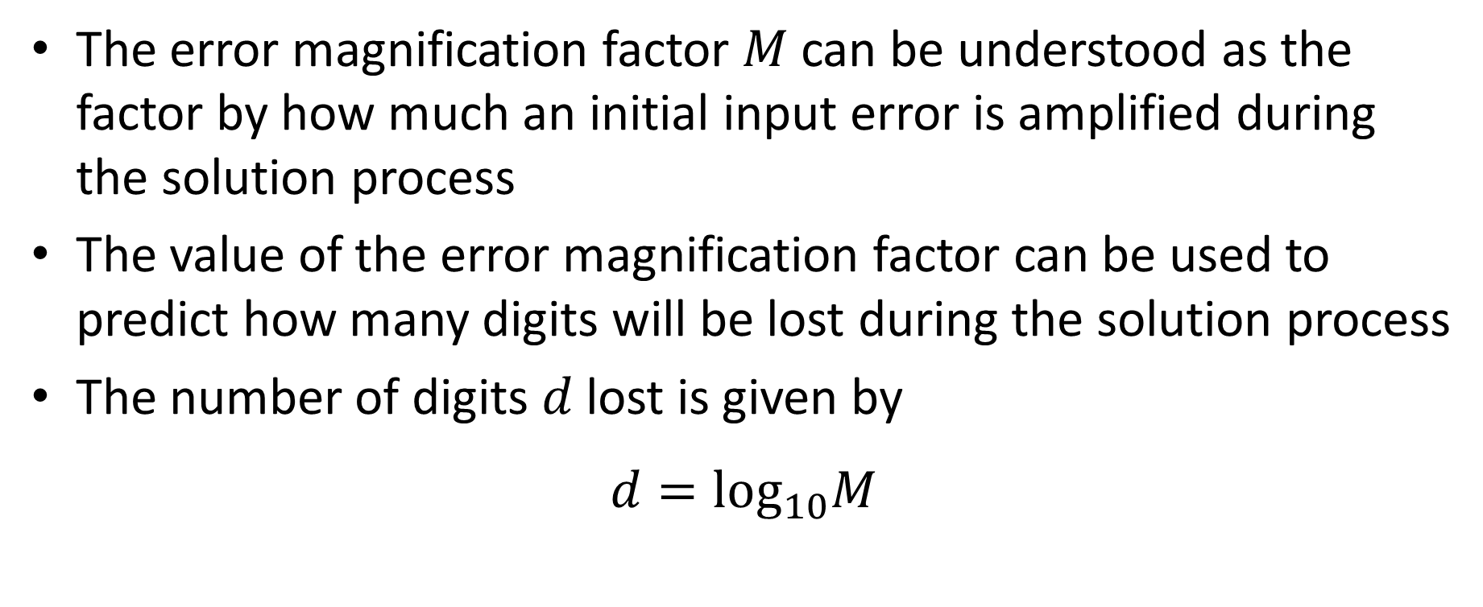
Summary
The error magnification factor $M$ can be understood as the factor by how much an initial input error is amplified during the solution process
The value of the error magnification factor can be used to predict how many digits will be lost during the solution process
The number of digits $d$lost is given by
$$d=\log_{10}M$$
Notes:
Let us summarize our key findings
The error magnification factor $M$ can be understood as the factor by how much an initial input error is amplified during the solution process
The value of the error magnification factor can be used to predict how many digits will be lost during the solution process
The number of digits $d$lost is given by the decimal logarithm of the error magnification factor.

